Slide 1

Software Engineering II
Lecture 31
CS61B, Spring 2024 @ UC Berkeley

Slide 2


Background
Dominic Conricode (he/him)
Vanessa Teo (she/her)
Senior majoring in CS
5th Semester on staff
Thinks space is cool
Junior majoring in CS + Environmental Econ & Policy
4th semester on staff
Has two cats

Slide 3

Today’s lecture will be about the building a project from the ground up. The concepts we’ll discuss today can be used right now! They’ll also apply forever :)
General Q&A will be at the end.
Credit for many of these slides goes to:
Josh Hug
Stella Kaval
Noah Adhikari
(and us)

Slide 4
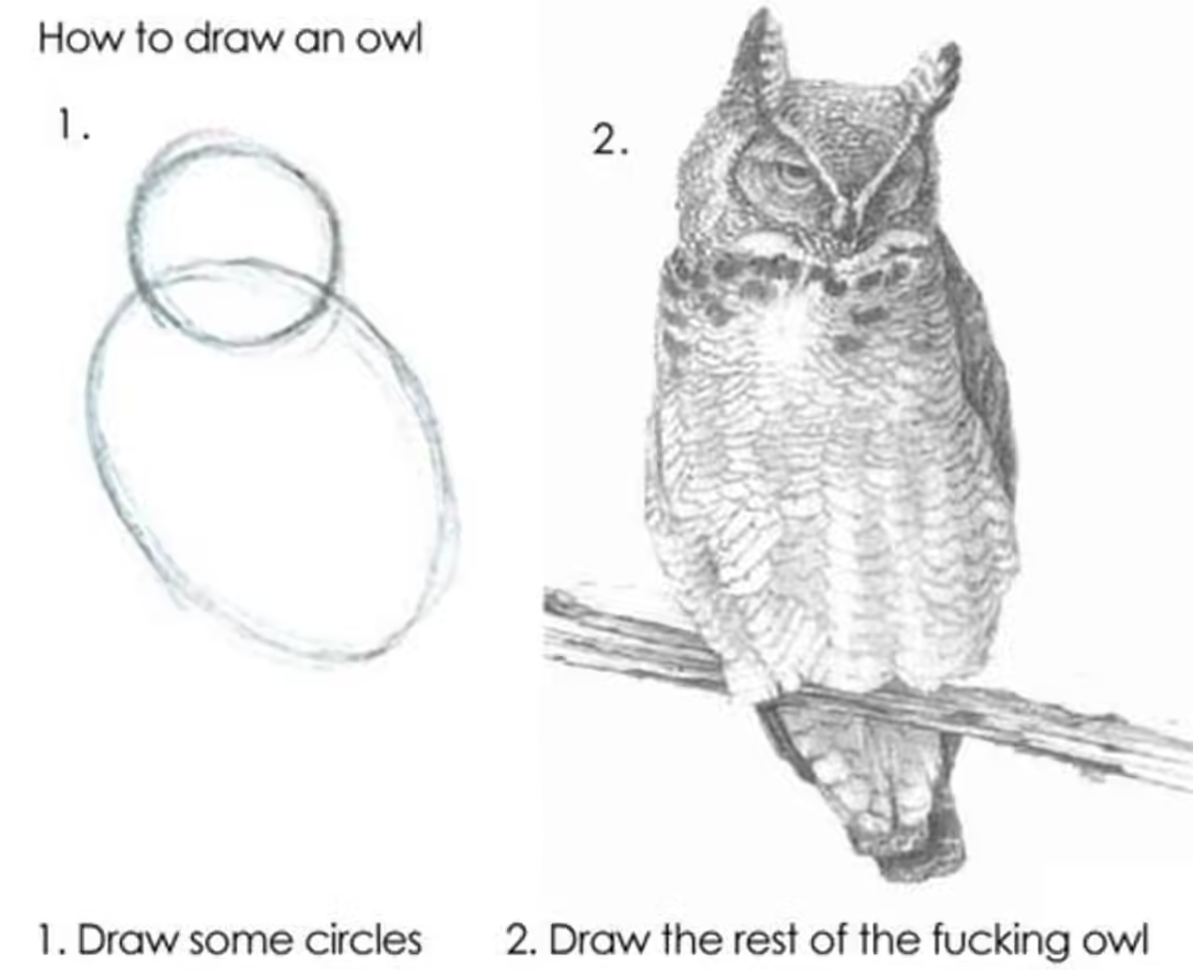
Design
Design
Managing Complexity
Documentation
Working in a Team
Q & A
Lecture 31, CS61B, Spring 2024

Slide 5
Why Design?
“Instead of wasting time by designing my program, I can save time by starting to code now” - Person who will regret their decision soon™
Design is an important first stage in development:
Ensures consideration of all requirements and constraints
Considers multiple alternatives and their advantages / disadvantages
Identifies potential costs or pitfalls while change is cheap
Allows multiple minds to weigh in and leverages diverse perspectives

Slide 6
Design Documents
Design documents do not need to follow a specific form, but they should give the reader easily accessible information about your project.
A design document should:
Quickly bring the reader up to speed
Include what alternatives were considered and why the trade-offs were made
Be just as much about the “why” as it is about the “how”
Update as the project progresses (be alive!)
Notes:
Credit to this great article: https://www.industrialempathy.com/posts/design-docs-at-google/

Slide 7

Design Documents
Often, design documents will be reviewed before work on the project even begins.
When onboarding to an existing project, the first question someone will ask is “where’s the design doc?”
Chromium: https://www.chromium.org/developers/design-documents/

Slide 8
Design in Project 3
Think about each class you want to create and how they will fit together
Putting everything into one file will make you sad :(
Ideally each class should have one role
Consider what methods are required to meet each class’s functionality
The major algorithms you’ll need to think about are room and hallway generation
You are making something new!

Slide 9
Managing Complexity
Design
Managing Complexity
Documentation
Working on a Team
Q&A
Lecture 31, CS61B, Spring 2024

Slide 10

Who Cares?
Who Cares?
You probably don’t want your work to end up like Space Cadet Pinball
Notes:
Source: Full Tilt! Pinball - Wikipedia

Slide 11
Technical Debt
Your work will be available to other people.
People are going to build off of it, or at least see it.
Maybe this is your future self!
Ideally, it should be flawless and well-documented.
Deadlines exist.
School deadlines, grants, conferences, reviews, etc.
Prototypical, hastily-written code is inevitable.
There is pressure to achieve both quality and quantity.
This is inarguably a trade-off—prioritizing one will negatively affect the other.
This doesn’t just apply to code—it applies to life.
How do you deal with this? See Strategic vs Tactical Programming from SWE I.

Slide 12
Importance
What is “good code”? Three main goals:
Readability: The code is easy to read and understand.
Simplicity: The solution is straightforward, without unnecessary complexity
Testability: The code is easy to test and debug.
Why is good code important?
Facilitates easier maintenance and debugging
Enhances collaboration and code readability
Directly impacts the success and scalability of project

Slide 13
Bad Style
Poor and Inconsistent Formatting
Multiple styles mixed in the same project
snake_case, camelCase, SCREAMING_SNAKE_CASE, flatcase, kebob-case
Over-Complexity
simple tasks are over-complicated by unnecessary steps or convoluted logic
repetitive code that re-implements the same logic

Slide 14
IMPORTANT NOTE!
Refactoring is changing your code to make things more organized without affecting functionality.
Before refactoring, always add and commit your code! This way, you can restore your old work if necessary.

Slide 15
Bad Code Example - What’s wrong with this?
static void print3DArray(String[][][] arrays) {
System.out.print("[");
for (int i = 0; i < arrays.length; i++) {
if (arrays[i] == null) {
continue;
}
System.out.print("[");
for (int j = 0; j < arrays[i].length; j++) {
if (arrays[i][j] == null) {
continue;
}
System.out.print("[");
for (int k = 0; k < arrays[i][j].length; k++) {
System.out.print(arrays[i][j][k]);
if (k < arrays[i][j].length - 1) {
System.out.print(", ");
}
}
System.out.print("]");
if (j < arrays[i].length - 1) {
System.out.print(", ");
}
}
System.out.print("]");
if (i < arrays.length - 1) {
System.out.print(", ");
}
}
System.out.print("]\n");
}
I have no idea what’s going on
Probably prints 3D arrays?

Slide 16
Bad Code Example - Test to verify correctness as you refactor
public static void main(String[] args) {
String[][][] arrays = new String[][][] {
new String[][] {
new String[] {"1", "2", "3"},
new String[] {"4", "5", "6"},
new String[] {"7", "8", "9"}
},
null,
new String[][] {
new String[] {"10", "11", "12"},
new String[] {"13", "14", "15"},
new String[] {"16", "17", "18"}
}
};
print3DArray(arrays);
}
Small test
[[[1, 2, 3], [4, 5, 6], [7, 8, 9]], [[10, 11, 12], [13, 14, 15], [16, 17, 18]]]
Hey, it works! Why change it?

Slide 17
Bad Code Example - Use the tools of the language
static void print3DArray(String[][][] arrays) {
System.out.print("[");
for (String[][] array : arrays) {
if (array == null) {
continue;
}
System.out.print("[");
for (String[] arr : array) {
if (arr == null) {
continue;
}
System.out.print("[");
for (String a : arr) {
System.out.print(a + ", ");
}
System.out.print("], ");
}
System.out.print("], ");
}
System.out.print("]\n");
}
Enhanced-for loops exist
Still bad, but much better, even with terrible variable names
Small test
[[[1, 2, 3][4, 5, 6][7, 8, 9]][[10, 11, 12][13, 14, 15][16, 17, 18]]]
Hey, you broke it! Change it back!

Slide 18
Bad Code Example 2 - Avoid “goto” statements where possible
static void print3DArray(String[][][] arrays) {
System.out.print("[");
for (String[][] array : arrays) {
if (array != null) {
System.out.print("[");
for (String[] arr : array) {
if (arr != null) {
System.out.print("[");
for (String a : arr) {
System.out.print(a + ", ");
}
System.out.print("], ");
}
}
System.out.print("], ");
}
}
System.out.print("]\n");
}
In general, this is a good idea, but it didn’t help much here…
Braces and indentation are even worse than before
Also, the code is still broken :(

Slide 19
Bad Code Example - Separate logic into simple methods
static void print3DArray(String[][][] arrays) {
System.out.print("[");
for (String[][] array : arrays) {
print2DArray(array);
System.out.print(", ");
}
System.out.print("]\n");
}
static void print2DArray(String[][] array) {
if (array != null) {
System.out.print("[");
for (String[] arr : array) {
print1DArray(arr);
System.out.print(", ");
}
System.out.print("]");
}
}
static void print1DArray(String[] arr) {
if (arr != null) {
System.out.print("[");
for (String a : arr) {
System.out.print(a + ", ");
}
System.out.print("]");
}
}
Much better!
Our test still doesn’t work.
[[[1, 2, 3, ], [4, 5, 6, ], [7, 8, 9, ], ], [[10, 11, 12, ], [13, 14, 15, ], [16, 17, 18, ], ], ]
Weird comma behavior for the last element of arrays.
Notably, we have this problem for every nested array
We have identical print statements for the commas and square brackets everywhere, with similar issues for all of them.
Something like generic types would probably come in handy here, but these methods are static…
Notes:
Google how to have static generic types java.

Slide 20
Bad Code Example - Code generically; don’t repeat yourself
static void print3DArray(String[][][] arrays) {
printCommaSeparated(arrays);
System.out.print("\n");
}
static void print2DArray(String[][] array) {
printCommaSeparated(array);
}
static void print1DArray(String[] arr) {
printCommaSeparated(arr);
}
static <T> void printCommaSeparated(T[] arr) {
if (arr != null) {
System.out.print("[");
for (int i = 0; i < arr.length; i++) {
System.out.print(arr[i]);
if (i < arr.length - 1) {
System.out.print(", ");
}
}
System.out.print("]");
}
}
You actually can have generic static methods in Java.
[[[Ljava.lang.String;@e9e54c2, null, [[Ljava.lang.String;@65ab7765]
?!
Notes:
Google how to print arrays in java

Slide 21
Bad Code Example - Don’t reinvent the wheel
static void print3DArray(String[][][] arrays) {
printCommaSeparated(arrays);
System.out.print("\n");
}
static void print2DArray(String[][] array) {
printCommaSeparated(array);
}
static void print1DArray(String[] arr) {
printCommaSeparated(arr);
}
static <T> void printCommaSeparated(T[] arr) {
if (arr != null) {
System.out.print(Arrays.toString(arr));
}
}
[[[Ljava.lang.String;@e9e54c2, null, [[Ljava.lang.String;@65ab7765]
This occurs due to the nested-ness of our problem.
This is actually pretty annoying to resolve - an exercise for the brave amongst you is to fix it without using the library solution.

Slide 22
Better Code Example - Cheat Don’t reinvent the wheel, again
static <T> void printArray(T[] arr) {
System.out.print(Arrays.deepToString(arr));
}
[[[1, 2, 3], [4, 5, 6], [7, 8, 9]], null, [[10, 11, 12], [13, 14, 15], [16, 17, 18]]]
Yes, we have that null in there, but it’s totally a feature, not a bug
This now works for any amount of nested arrays. And any (non-primitive) type of array!

Slide 23
Original vs Refactored
static void print3DArray(String[][][] arrays) {
System.out.print("[");
for (int i = 0; i < arrays.length; i++) {
if (arrays[i] == null) {
continue;
}
System.out.print("[");
for (int j = 0; j < arrays[i].length; j++) {
if (arrays[i][j] == null) {
continue;
}
System.out.print("[");
for (int k = 0; k < arrays[i][j].length; k++) {
System.out.print(arrays[i][j][k]);
if (k < arrays[i][j].length - 1) {
System.out.print(", ");
}
}
System.out.print("]");
if (j < arrays[i].length - 1) {
System.out.print(", ");
}
}
System.out.print("]");
if (i < arrays.length - 1) {
System.out.print(", ");
}
}
System.out.print("]\n");
}
static <T> void printArray(T[] arr) {
System.out.print(Arrays.deepToString(arr));
}

Slide 24

Bonus: Quake III - Fast Inverse Square Root (with original comments)
float q_rsqrt(float number)
{
long i;
float x2, y;
const float threehalfs = 1.5F;
x2 = number * 0.5F;
y = number;
i = * ( long * ) &y; // evil floating point bit level hacking
i = 0x5f3759df - ( i >> 1 ); // what the fuck?
y = * ( float * ) &i;
y = y * ( threehalfs - ( x2 * y * y ) ); // 1st iteration
// y = y * ( threehalfs - ( x2 * y * y ) ); // 2nd iteration, this can be removed
return y;
}
Notes:
Fast inverse square root - Wikipedia
In 1999 people were making this game called Quake III which was a 3D arena game. Look at how the guy is looking at himself in the mirror! This involved lots of lighting calculations, which require this operation a TON to normalize vectors.
Not going to go into the weeds of this here, you can Google it if you want. Also, this was written in C. You don’t have to worry too much about what this code is doing (granted I can’t even tell you what it’s doing) but you’ll learn a bit more about this notation in 61C if you decide to take it.
TLDR, this code is SUPER fast/efficient and was actually used in production. When they released the source code, people were like what the hell does any of this mean? Everyone wanted to learn how this code worked and how to incorporate and build off of it because of how fast it was.
Hopefully your comments look better than this, and magic numbers are bad. Only in 2018 (20 years later) was a mathematical analysis found for why this number is what it is…

Slide 25
Good Style and Clean Code Guidelines
Every company has preferences, and you must follow their conventions
Google Style Guide
61B’s Style Guide!
Not a complete list of guidelines!
Add and commit before and after a refactor
Understand what your code needs to do
Avoid unnecessarily complex ways of doing things
Use descriptive method and variable names, and document your code well
Separate logic into simpler methods
Don’t reinvent the wheel
Google and StackOverflow are your friend

Slide 26
Writing Clean Code, Summary
Refactoring is hard.
No immediate clear gains—it’s all investment in the future
The more that is built on top of your bad code, the worse the problem becomes
It’s hard to tell what’ll break, and more will break the longer you wait
Code cleanly from the start!

Slide 27
Documentation
Design
Managing Complexity
Documentation
Working in a Team
Q&A
Lecture 31, CS61B, Spring 2024

Slide 28
Documentation Intro
Documentation in technology refers to various written materials that accompany software or systems
It covers a broad spectrum, including:
Code Comments
API Documentation
User Manuals
Design Specifications
Test Documents
We'll concentrate on practical documentation strategies that you can directly apply to your projects today

Slide 29
Why Documentation?
"We don't have enough time”
Quick documentation now avoids longer explanations later
"No-one would read it anyway”
I highly doubt it
Serves as a guide for future developers and users of the code
Essential for maintaining and scaling projects
In Project 3, your partner will benefit from reading it
"The code should be self-documenting”
Would you rather read 100 lines of someone’s code or a short summary?
Documentation explains why and the context, not just how

Slide 30
Documentation Example
What can we improve about this documentation?
Are we moving trees? Are we moving the player?
Why are we including java.util.Random?
What are x and y?
/**
* Changes location of the trees in the world
* We use java.util.Random.
*/
public boolean movePlayer(int x, int y) {...}

Slide 31
Documentation Example
/**
* Moves the player to a specified location within the game world.
* Validates the destination and checks for bounds.
*
* @param x The x-coordinate of the destination (horizontal position).
* @param y The y-coordinate of the destination (vertical position).
* @return 'true' if the move is successful, 'false' otherwise.
* @throws OutOfBoundsException if coordinates are outside the world.
* @usage To move the player to (5, 10), call movePlayer(5, 10).
*/
public boolean movePlayer(int x, int y) {...}

Slide 32
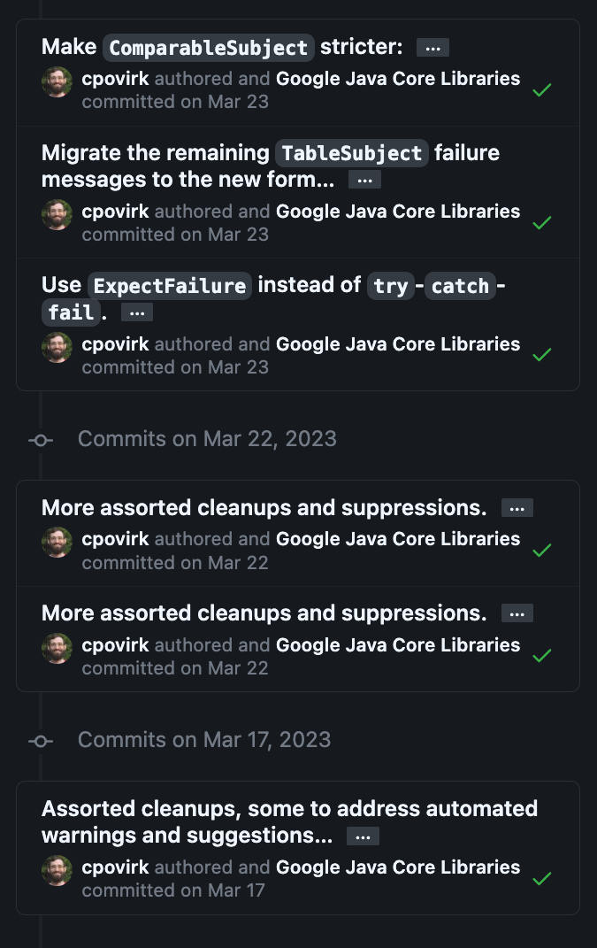
Writing Good Git Commits
There are well-established conventions:
Capitalize the subject line
Use imperative mood in the subject line
If applied, this commit will <subject line here>
Use the body to explain what and why vs how
Code already says how, but we need why
If it is complex, add source comments
Limit subject line to 50 characters (soft rule)
Ensures that commits are readable
If you hard time summarizing, you might be committing too many changes at once.
Rules: https://cbea.ms/git-commit/
Example: Google Truth Library (We use for writing tests!)

Slide 33
Writing Good Git Commits
Good Commit Messages:
Add room generation logic
Fix overlapping rooms
Make world generation tests
Document world generation algorithm
Start persistence logic
Refactor persistence logic to use RandomUtils
Reformat game homepage text to use more whitespace
Rearrange buttons so OK is on the lower right
Revise link to update it to the new URL

Slide 34
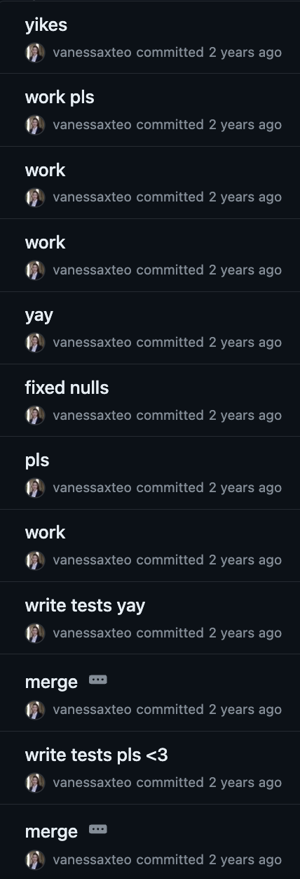
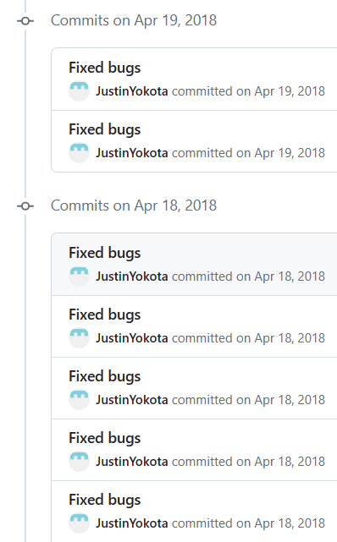
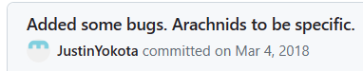
Some Bad Commit Messages
Notes:
#tbt to when justin and i were both 61b students LOL

Slide 35
Overview
Poor documentation can impact productivity in three main areas:
Searchability
Time lost in deciphering and navigating code
Might end up rewriting the same code multiple times
Onboarding
Everyone’s implementations are different
In office hours, you will be onboarding course staff to your project
Industry examples
Collaboration
You and a partner will be writing code that both of you should understand

Slide 36
Working in a Team
Design
Managing Complexity
Documentation
Working in a Team
Q&A
Lecture 31, CS61B, Spring 2024

Slide 37
Project 3: BYOW
Project 3 is a team project.
This semester, as in most of the recent past, we’re doing teams of 2.
Two main reasons:
Get practice working on a team.
Get more creativity into the project since it’s so open ended.
Ancillary reason: Also reduces programming workload per person, but the project is small enough that a single person can handle it.

Slide 38
Teamwork is Hard
In the real world, some tasks are much too large to be handled by a single person.
When faced with the same task, some teams succeed, where others may fail.
Last semester, ~9% of partnerships thought their partnership did not work well for them.

Slide 39
Individual Intelligence
In 1904, Spearman very famously demonstrated the existence of an “intelligence” factor in humans. As described in Woolley (2010):
“People who do well on one mental task tend to do well on most others, despite large variations in the tests’ contents and methods of administration.” This mysterious factor is called “intelligence.”
Intelligence can be quickly measured (less than an hour).
Intelligence reliably predicts important life outcomes over a long period of time, including:
Grades in school.
Success in occupations.
Even life expectancy.
Note: There is nothing in Spearman’s work that says that this factor is genetic.

Slide 40
Group Intelligence
In the famous “Evidence for a Collective Intelligence Factor in the Performance of Human Groups”, Woolley et. al investigated the success of teams of humans on various tasks.
They found that performance on a wide variety of tasks is correlated, i.e. groups that do well on any specific task tend to do very well on the others.
This suggests that groups do have “group intelligence” analogous to individual intelligence as demonstrated by Spearman.

Slide 41
Group Intelligence
In the famous “Evidence for a Collective Intelligence Factor in the Performance of Human Groups”, Woolley et. al investigated the success of teams of humans on various tasks.
Studying individual group members, Woolley et. al found that:
Collective intelligence is not significantly correlated with average or max intelligence of each group.
Instead, collective intelligence was correlated with three things:
Average social sensitivity of group members as measured using the “Reading the Mind in the Eyes Test” (this is really interesting).

Slide 42
Group Intelligence
In the famous “Evidence for a Collective Intelligence Factor in the Performance of Human Groups”, Woolley et. al investigated the success of teams of humans on various tasks.
Studying individual group members, Woolley et. al found that:
Collective intelligence is not significantly correlated with average or max intelligence of each group.
Instead, collective intelligence was correlated with three things:
Average social sensitivity of group members as measured using the “Reading the Mind in the Eyes Test” (this is really interesting).
How equally distributed the group was in conversational turn-taking, e.g. groups where one person dominated did poorly.

Slide 43
Group Intelligence
In the famous “Evidence for a Collective Intelligence Factor in the Performance of Human Groups”, Woolley et. al investigated the success of teams of humans on various tasks.
Studying individual group members, Woolley et. al found that:
Collective intelligence is not significantly correlated with average or max intelligence of each group.
Instead, collective intelligence was correlated with three things:
Average social sensitivity of group members as measured using the “Reading the Mind in the Eyes Test” (this is really interesting).
How equally distributed the group was in conversational turn-taking, e.g. groups where one person dominated did poorly.
Percentage of females in the group (paper suggests this is due to correlation with greater social sensitivity).

Slide 44
Project 3
Presumably, learning habits that lead to greater group intelligence is possible.
We hope that project 3 helps with this.
Recognize that teamwork is also about relationships!
Treat each other with respect.
Be open and honest with each other.
Make sure to set clear expectations.
… and if those expectations are not met, confront this fact head on.

Slide 45
Reflexivity
Important part of teamwork is “reflexivity”.
“A group’s ability to collectively reflect upon team objectives, strategies, and processes, and to adapt to them accordingly.”
Recommended that you “cultivate a collaborative environment in which giving and receiving feedback on an ongoing basis is seen as a mechanism for reflection and learning.”
It’s OK and even expected for you and your partner to be a bit unevenly matched in terms of programming ability.
You might find this description of best practices for team feedback useful, though it’s targeted more towards larger team projects.
Some key ideas from this document follow.

Slide 46
Feedback is Hard
Most of us have received feedback from someone which felt judgmental or in bad faith.
Thus, we’re afraid to give even constructive negative feedback for fear that our feedback will be misconstrued as an attack.
And we’re conditioned to watch out for negative feedback that is ill-intentioned.
Notes:
Assume best intentions in your teammate!!

Slide 47
Feedback is Hard
Feedback can also feel like a waste of time:
You may find it a pointless exercise to reflect on your partnership during the project. What does that have to do with a programming class?
In the real world, the same thing happens. Your team has limited time to figure out “what” to do, so why stop and waste time reflecting on “how” you’re working together?

Slide 48
Feedback is Hard
Feedback can simply be difficult to produce.
You may build incredible technical skills, but learning to provide useful feedback is hard!
Without confidence in ability to provide feedback, you may wait until you are forced to do so by annual reviews or other structured time to provide it.
If you feel like your partnership could be better, try to talk about it without waiting until you have to review each other at the end of next week.

Slide 49

Strategies for Collaboration: Pair Programming
Pair programming is a technique where two programmers work on a single station
Driver: focus on implementation
Navigator: consider design, accuracy
Benefits:
Reduce errors
Improve code quality
Increase productivity
Tips:
Clearly define roles
Swap often (15-30 mins)
You can do this remotely too! IntelliJ: Code With Me
VS Code: Live Share

Slide 50
Strategies for Collaboration: Communication
In industry, you will likely have frequent stand-up meetings to discuss:
What you are working on
If anything is blocking your progress
If you need feedback or advice from a team member
Keep each other up-to-date with progress!

Slide 51
Q&A
Design
Managing Complexity
Documentation
Teamwork
Q&A
Lecture 31, CS61B, Spring 2024

